Slide 1
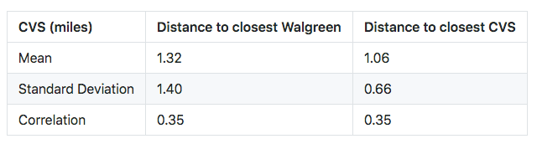
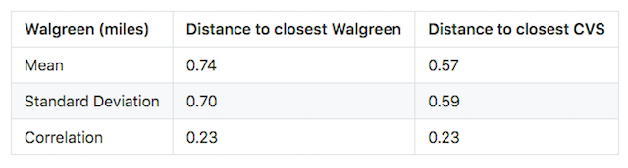
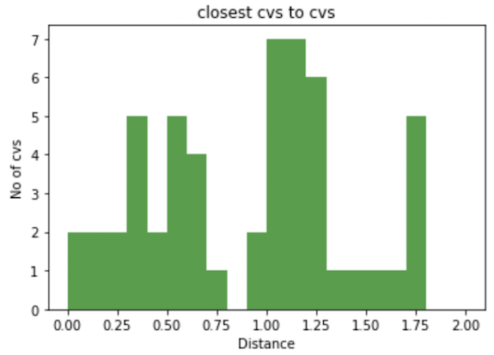
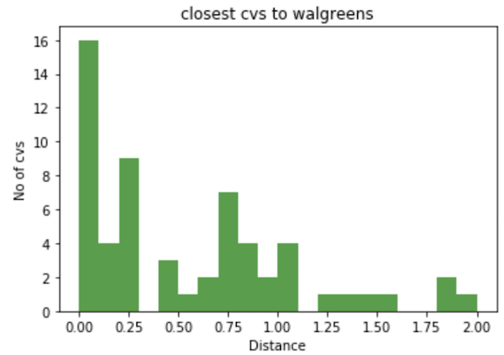
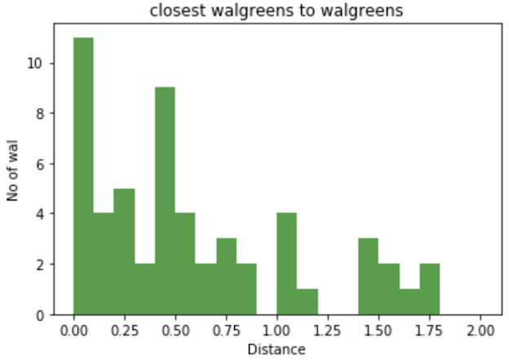
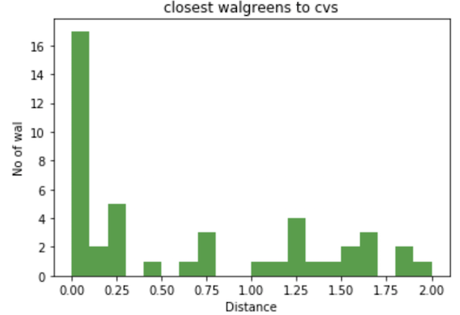
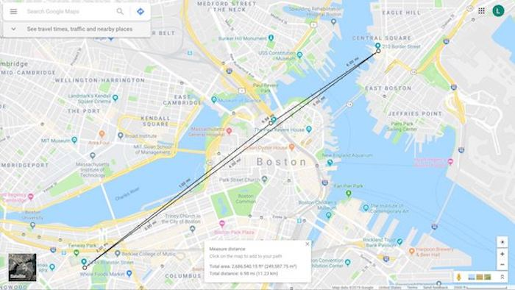
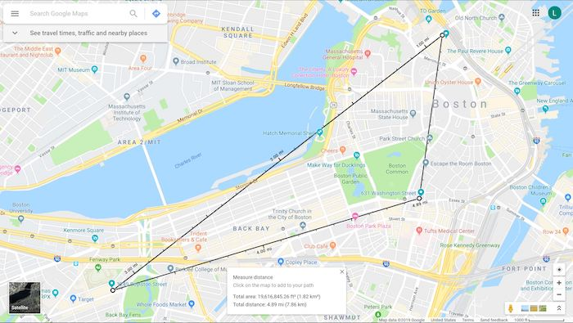


bu.edu/cs
TITLE PUTS HERE
Jia Jia Shen, Shiwei Chen, Yuanpei Wang
jshen97@bu.edu, leochans@bu.edu, wangyp@bu.edu
CS 504 Data Mechanics
Introduction
Data Visualizations and Analysis
Conclusion of the Problem
Map Visualizations
It is said that we are living in an Age of Data. Data are literally omnipresent in our day-to-day life--Every Ad we see, every video or music recommendation we get, every choice we make--Data act behind the scene.
Project Pharmacy begins with a question that: What if we obtain one or two "host" datasets along with several "guest" datasets. Then before continue onto manipulating them, we first assume there is some kinds of relationships between the "host" and the "guests". Finally after performing some statistical or operational tests, will the outcomes bring us any interesting conclusions?
The project treated the CVS/ Walgreen pharmacy stores in central Boston area as the “host” datasets and several other interesting “guest” datasets as described in the following section.
We find that some CVS and Walgreen stores are next to each other. So for each CVS stores in Boston area, we find the closest Walgreen and CVS stores and record their distances, same for Walgreen stores. Results are shown below
The locations of Walgreen stores are intensive because it has lower mean value and standard deviation. Also, Walgreen are more likely to locate their stores closer to CVS stores
Datasets Used and Transformations
we plot the histograms shown above. It is interesting that there are around 16 pairs of CVS and Walgreen right next to each other which is consistent with our intuition. It is reasonable to believe that density of CVS and Walgreen stores is proportional with the density of population. Hopefully, we can have further investigation about the location selection in next part of the project
Google Places API (search Nearby)
CVS, Walgreen, and 7Eleven stores within 15 km Boston area
Boston supermarket or grocery store using google API
Data Mechanics IO
Eviction Incidents and Crime Incidents in Boston Area
Boston house_hold_income
Boston poverty_rate
Transformation Implementations
walgreenCrime: combine the Walgreen dataset and crimes dataset
walgreenEviction: combine the Walgreen dataset and eviction dataset
correlationCVS: recorded the calculated results of the correlations between CVS ratings and Larceny cases, CVS ratings and Eviction cases
countEvictionCrimeCVS: for every CVS pharmacy store, add two records. One for the number of Larceny cases nearby, and the other for the number of Eviction cases nearby
cvsCrime: combine the Walgreen dataset and CVS dataset, filtering every crime except for Larceny
cvsEviction: combine the CVS dataset and eviction dataset
ratingCrime: recorded a pair of (ratings, number of larceny cases) for every CVS store
ratingEviction: recorded a pair of (ratings, number of Eviction cases) for every CVS store
Explore Relationships between CVS, Larceny, and Eviction in the Central Boston
Solve the Optimization Problem
Finding the model that has the maximum (total stability S, total accessibility A) pair
Accessibility A is defined as the sum of the distances between each pair of salesmen, or each pair of stores that are assigned a salesman.
(S1, A1) > (S2, A2) if S1>S2 and A1>A2
Results:
the 3 CVS are located at 210 Border St,
East Boston 101 Canal St suite A, Boston 1249 Boylston St, Boston
with a total stability S = 0.4886
with a total accessibility A = 11.2147 km
Solve the Constraint Satisfaction Problem
If we have the chance to send 3 salesmen (1 per store), obtained the model that has the total stability >= S, total accessibility >= A?
Results:
For S := 0.6; A := 6.0:
a possible set of 3 CVS are:
101 Canal St suite A, 1249 Boylston St,631 Washington St, Boston
with a total S = 0.63646
with a total A = 7.91282
Limitations and Future Research
@BUCompSci

Slide 2
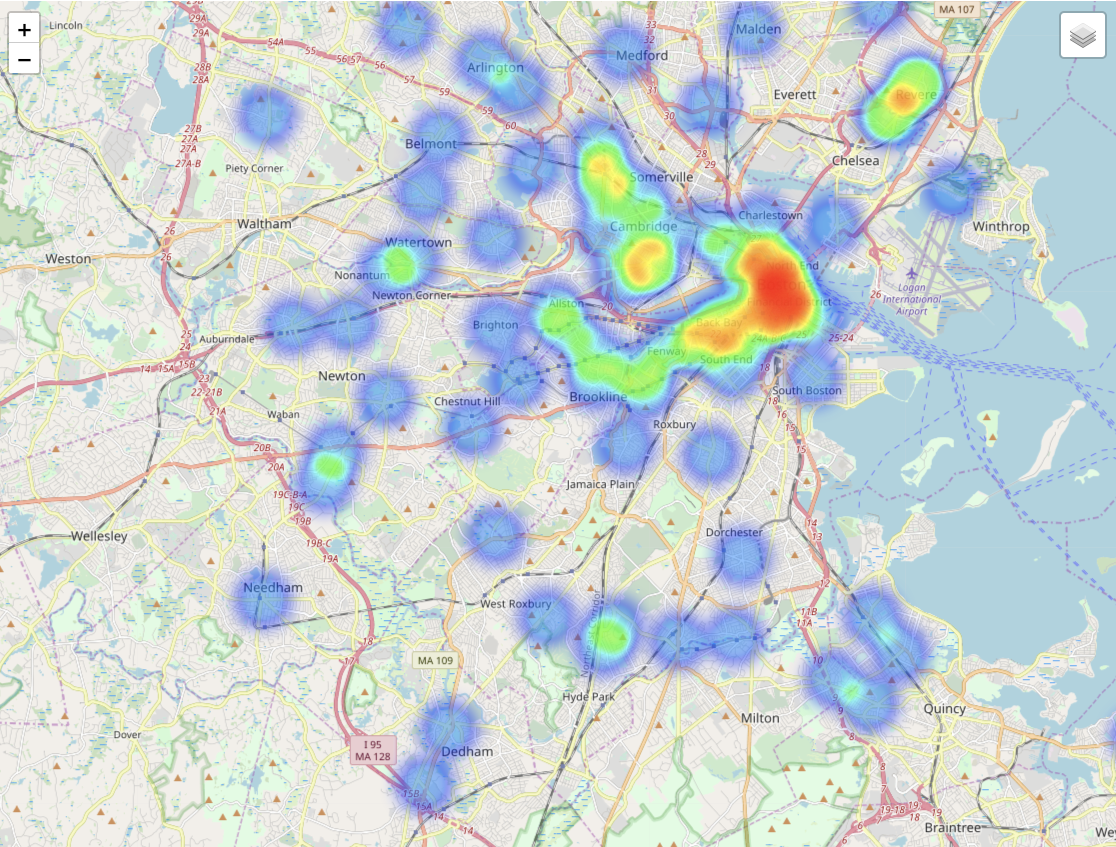
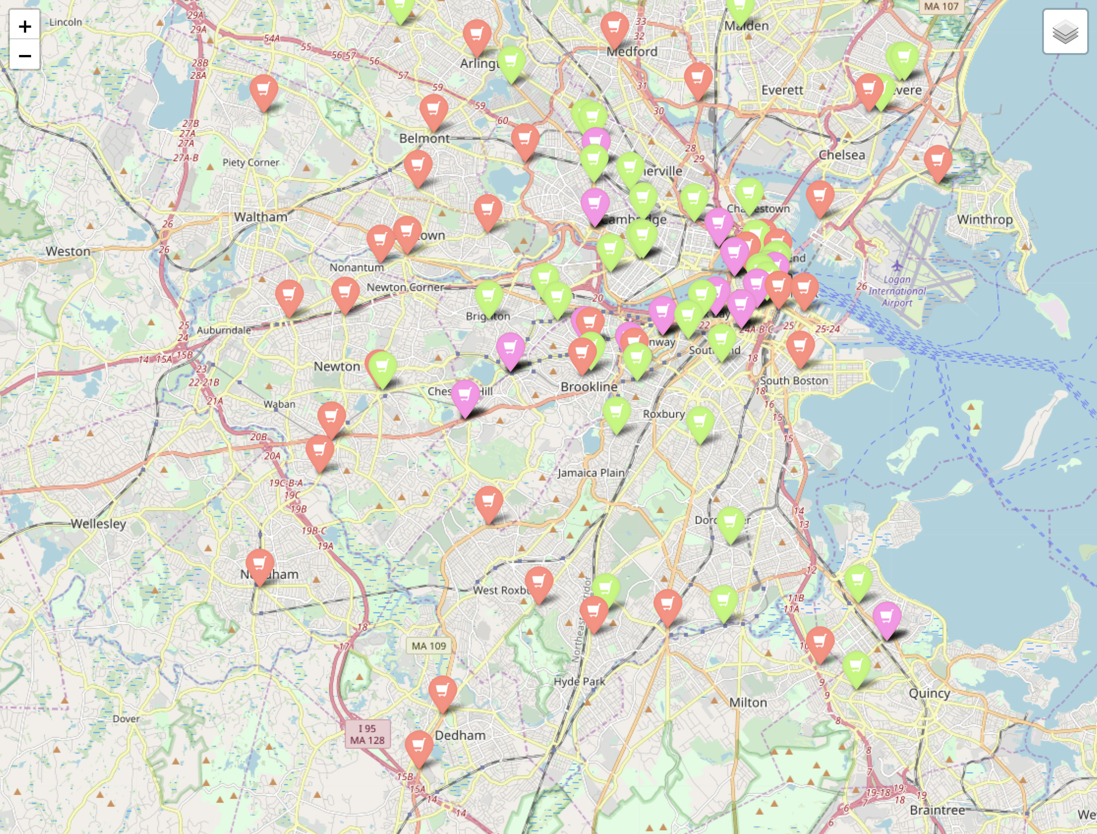
bu.edu/cs
TITLE PUTS HERE
Jia Jia Shen, Shiwei Chen, Yuanpei Wang
jshen97@bu.edu, leochans@bu.edu, wangyp@bu.edu
CS 504 Data Mechanics
Introduction
Data Visualizations and Analysis
Conclusion of the Problem
Map Visualizations
It is said that we are living in an Age of Data. Data are literally omnipresent in our day-to-day life--Every Ad we see, every video or music recommendation we get, every choice we make--Data act behind the scene.
Project Pharmacy begins with a question that: What if we obtain one or two "host" datasets along with several "guest" datasets. Then before continue onto manipulating them, we first assume there is some kinds of relationships between the "host" and the "guests". Finally after performing some statistical or operational tests, will the outcomes bring us any interesting conclusions?
The project treated the CVS/ Walgreen pharmacy stores in central Boston area as the “host” datasets and several other interesting “guest” datasets as described in the following section.
We find that some CVS and Walgreen stores are next to each other. So for each CVS stores in Boston area, we find the closest Walgreen and CVS stores and record their distances, same for Walgreen stores. Results are shown below
The locations of Walgreen stores are intensive because it has lower mean value and standard deviation. Also, Walgreen are more likely to locate their stores closer to CVS stores
Fig 1: heat map of CVS and Walgreen stores
Fig 2: Distribution of CVS and Walgreen stores
Datasets Used and Transformations
we plot the histograms shown above. It is interesting that there are around 16 pairs of CVS and Walgreen right next to each other which is consistent with our intuition. It is reasonable to believe that density of CVS and Walgreen stores is proportional with the density of population. Hopefully, we can have further investigation about the location selection in next part of the project
Fig 1 shows that CVS and Walgreen are gathered in the center of Boston Metro area, and spread out outside Boston. Fig 2 indicates the specific distribution of CVS and Walgreen stores. The red icon represents CVS while the green icon represents Walgreen and the pink icon represents the location where CVS and Walgreen are close to each other. From those two figures, we can tell that beside the center area of Boston where both CVS and Walgreen are compacted, CVS spreads out its stores more and almost each town contains at least one CVS while Walgreen focuses more on targeting the center of Boston.
Google Places API (search Nearby)
CVS, Walgreen, and 7Eleven stores within 15 km Boston area
Boston supermarket or grocery store using google API
Data Mechanics IO
Eviction Incidents and Crime Incidents in Boston Area
Boston house_hold_income
Boston poverty_rate
Transformation Implementations
walgreenCrime: combine the Walgreen dataset and crimes dataset
walgreenEviction: combine the Walgreen dataset and eviction dataset
correlationCVS: recorded the calculated results of the correlations between CVS ratings and Larceny cases, CVS ratings and Eviction cases
countEvictionCrimeCVS: for every CVS pharmacy store, add two records. One for the number of Larceny cases nearby, and the other for the number of Eviction cases nearby
cvsCrime: combine the Walgreen dataset and CVS dataset, filtering every crime except for Larceny
cvsEviction: combine the CVS dataset and eviction dataset
ratingCrime: recorded a pair of (ratings, number of larceny cases) for every CVS store
ratingEviction: recorded a pair of (ratings, number of Eviction cases) for every CVS store
Explore Relationships between CVS, Larceny, and Eviction in the Central Boston
Solve the Optimization Problem
Finding the model that has the maximum (total stability S, total accessibility A) pair
Accessibility A is defined as the sum of the distances between each pair of salesmen, or each pair of stores that are assigned a salesman.
(S1, A1) > (S2, A2) if S1>S2 and A1>A2
Results:
the 3 CVS are located at 210 Border St,
East Boston 101 Canal St suite A, Boston 1249 Boylston St, Boston
with a total stability S = 0.4886
with a total accessibility A = 11.2147 km
Solve the Constraint Satisfaction Problem
If we have the chance to send 3 salesmen (1 per store), obtained the model that has the total stability >= S, total accessibility >= A?
Results:
For S := 0.6; A := 6.0:
a possible set of 3 CVS are:
101 Canal St suite A, 1249 Boylston St,631 Washington St, Boston
with a total S = 0.63646
with a total A = 7.91282
Limitations and Future Research
We initiate our investigation on the brand competition between CVS and Walgreen. Due to the lack of dataset we can access, our analysis merely rely on the location distribution. If we can get more information such as poverty level, income rate, age composition, race and so on, perhaps we can have more understanding on how CVS/Walgreen and other competitive brands in general select their locations based on their brand strategy and what is their target population.
@BUCompSci

